Slide 1
Modal Analysis
Chul Min Yeum
Assistant Professor
Civil and Environmental Engineering
University of Waterloo, Canada
CIVE 497 – CIVE 700: Smart Structure Technology
Last updated: 2019-12-26

Slide 2
Reference
The slides summarize the following materials:
Peter Avitabile (2009). Experimental Modal Analysis (A Simple Non-Mathmatical Presentation).
https://classes.engineering.wustl.edu/2009/fall/mase431/PDF/modalana.pdf
https://slideplayer.com/slide/4671751/

Slide 3
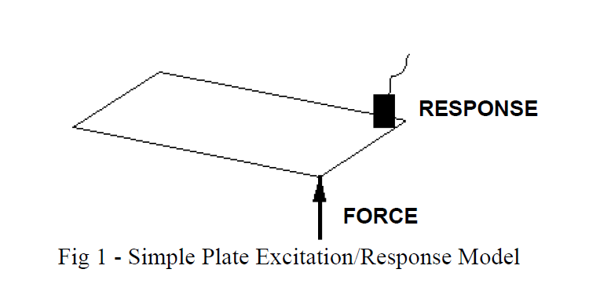

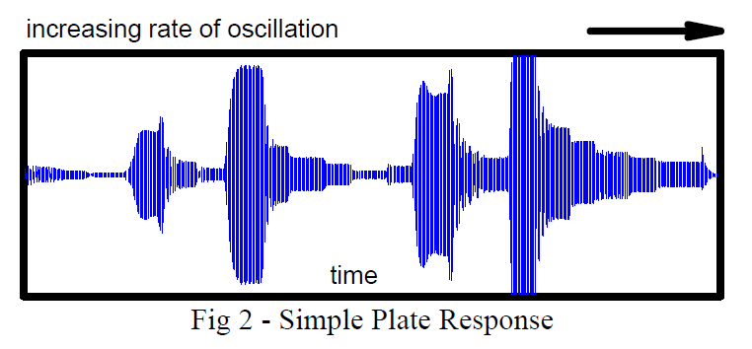
Could You Explain Modal Analysis for Me?

Slide 4
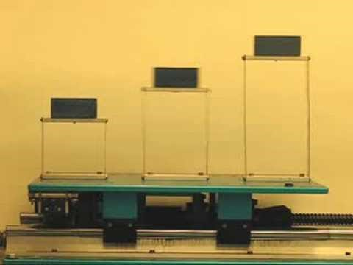
Example: Single Degree of Freedom Vibration Test

Slide 5
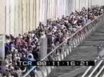
Example: Millennium Bridge, London

Slide 6
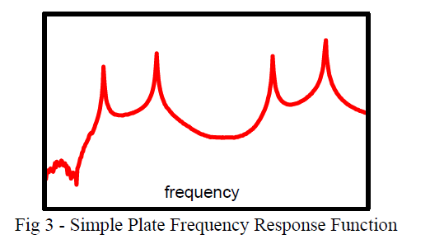
Could You Explain Modal Analysis for Me? (Continue)
…. The response amplifies as we apply a force with a rate of oscillation that gets closer to the natural frequency of the system and reaches a maximum when the rate of oscillation is at the resonant frequency of the system. ….
The deformation patterns at these natural frequencies also take on a variety of different shapes depending on which frequency is
used for the excitation force.

Slide 7
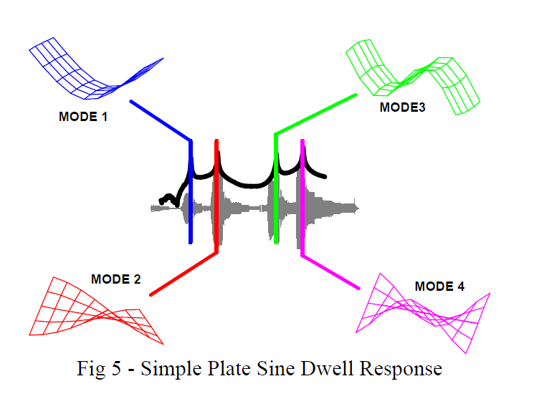
Could You Explain Modal Analysis for Me? (Continue)
Deformation patterns are referred to as the mode shapes of the structure.
The engineers identify natural frequency and know how they might affect the response of the structure when a force excites the structure.
Modal analysis is the study of the natural characteristics of structures. Understanding both the natural frequency and mode shape helps to design my structural system for noise and vibration applications.

Slide 8
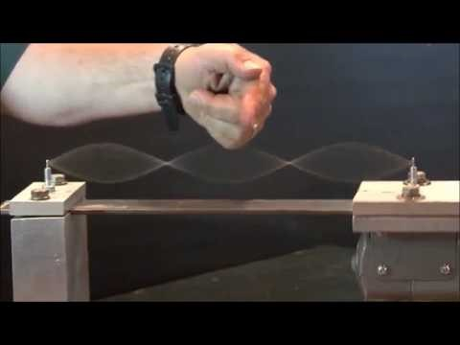
Examples: Different Mode Shape

Slide 9
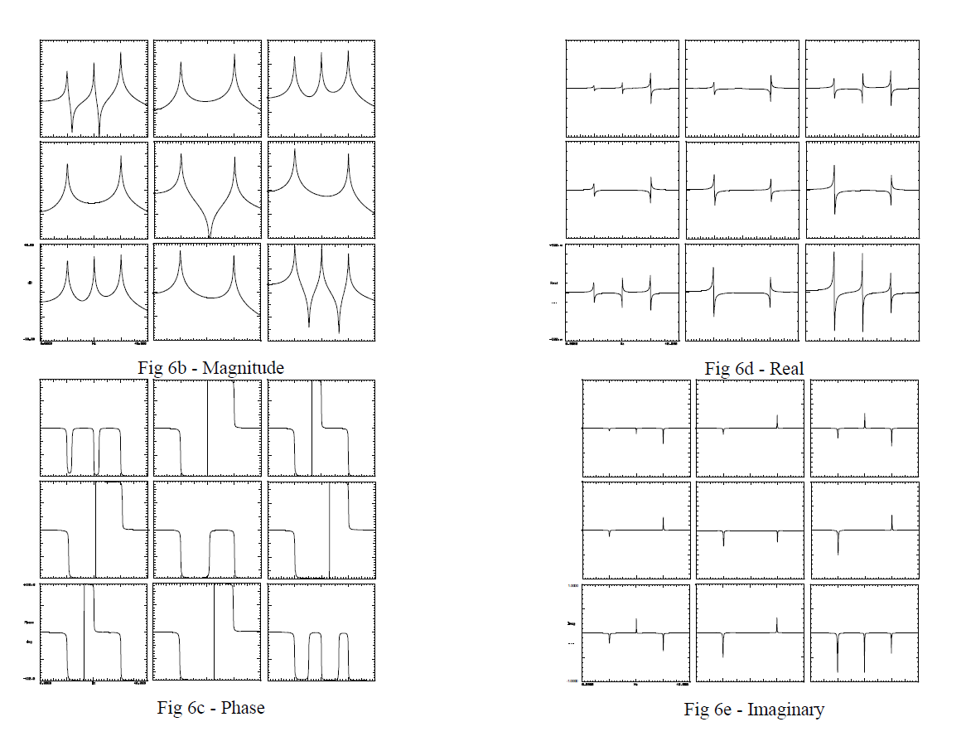
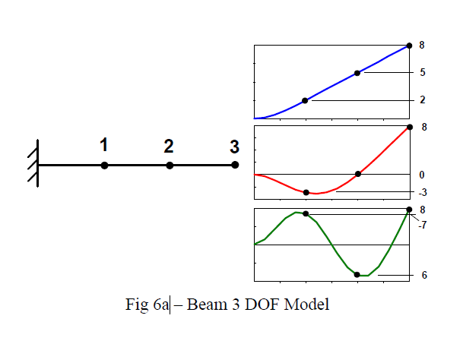
Just What are These Measurements that are Called FRFs?
Row: Heating, Column: Sensor location

Slide 10
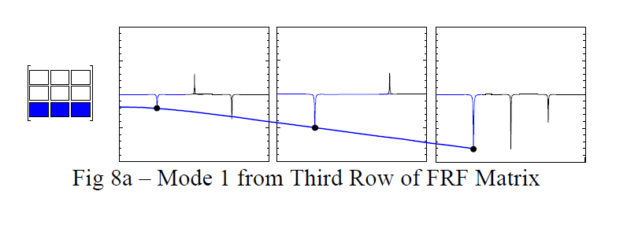
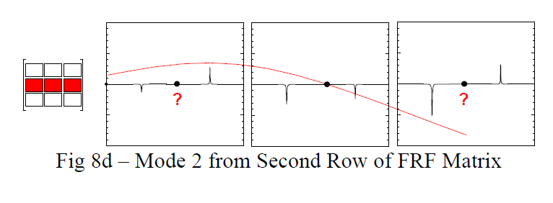
Why is Only One row or Column of the FRF Matrix Needed?
The frequency response function matrix is symmetric. The mass, damping, and stiffness matrices that describe the system are symmetric.
The reference point cannot be located at the node of a mode otherwise that mode will not be seen in the frequency response function measurement and the mode cannot be obtained (e.g. Do not hit the center of the simply supported beam but close to the center).

Slide 11
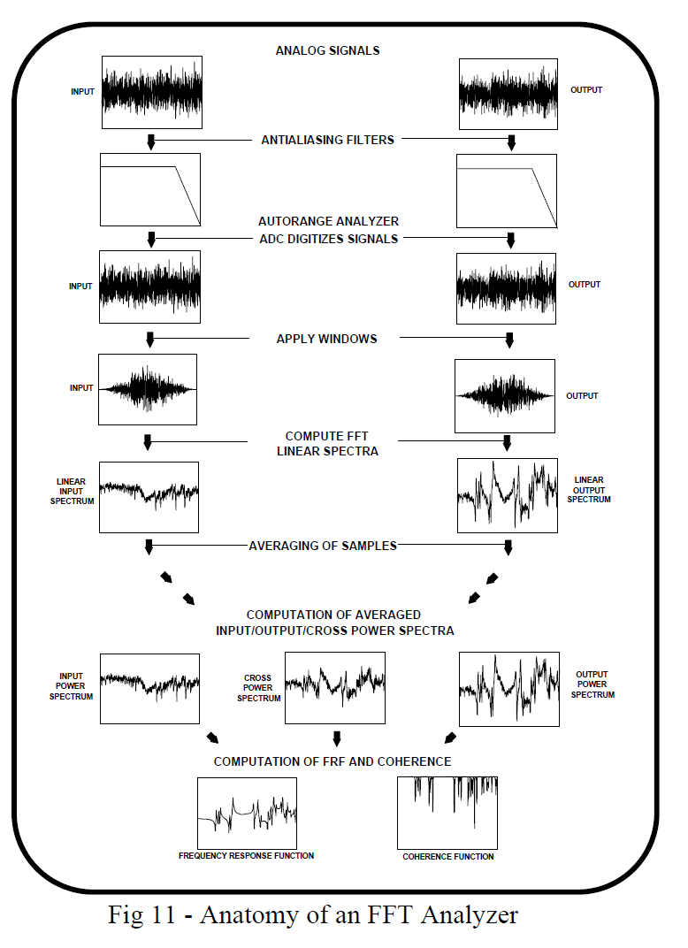
What Measurements do I Actually Make to Compute the FRF?

Slide 12
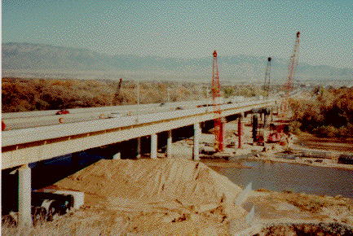
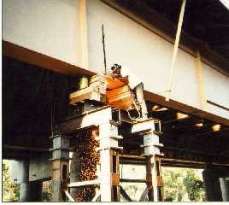
Example: Global Vibration Test of I-40 Bridge
Dam1
Dam2
Dam3
E-1
E-2
E-3
Dam4
E-4
Dam1
Dam2
Dam0
Dam3
First Experimental Frequency
Change in the first
mode frequency with
damage case
Dam0
Dam1
Dam2
Dam3
Dam4

Slide 13
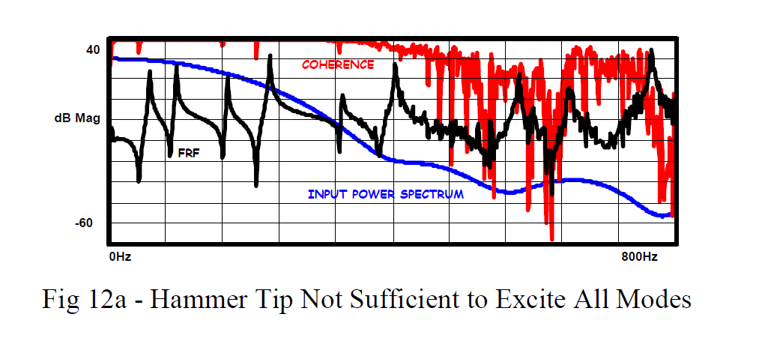
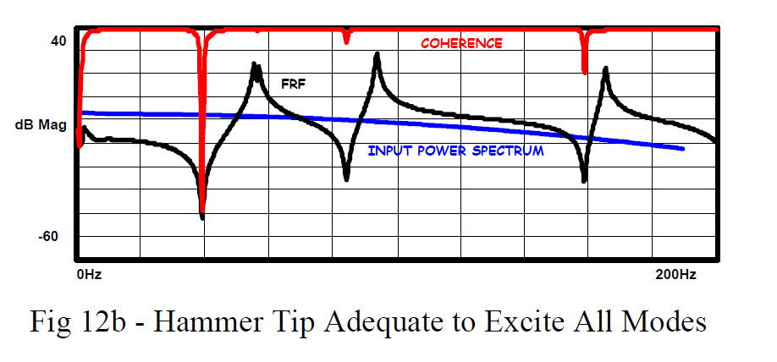
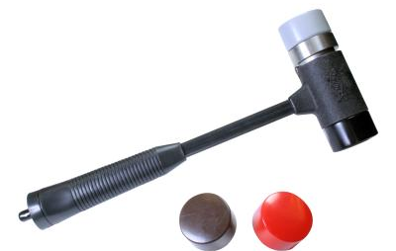
What are the biggest things to think about when impact testing?
1. Selection of the hammer tip: The input excitation frequency range is controlled mainly by the hardness of the tip selected.

Slide 14
Leakage
When the signal is not periodic or the period of the signal does not exactly match with the sampling period, the actual energy from a particular frequency is smeared into adjacent frequencies.
Leakage is one of the most serious errors in the frequency domain analysis.
Time windowing can be used to minimize the effect of leakage, but it does not completely remove the leakage problem.
Time windowing makes the captured signal look more periodic thereby reducing the effects of leakage.

Slide 15
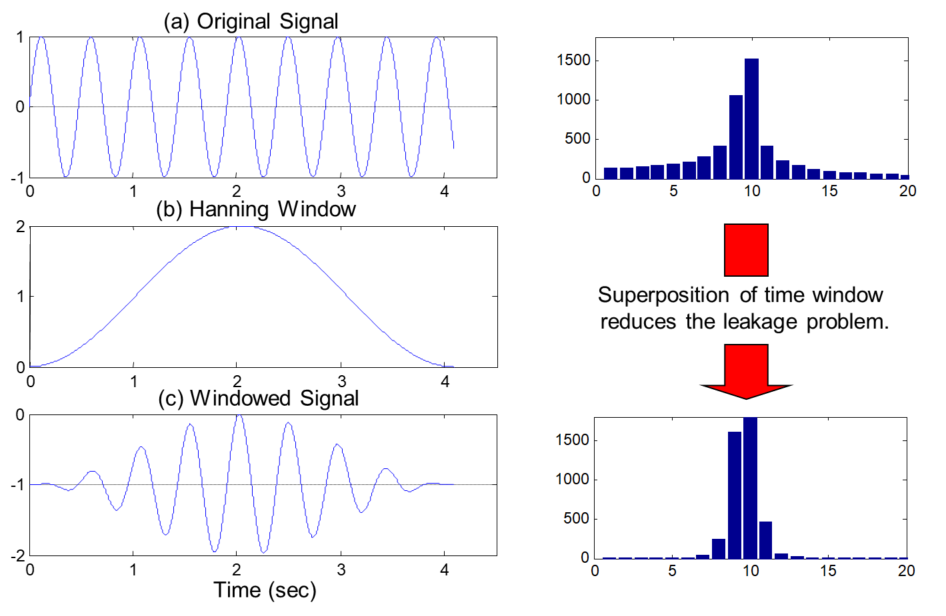
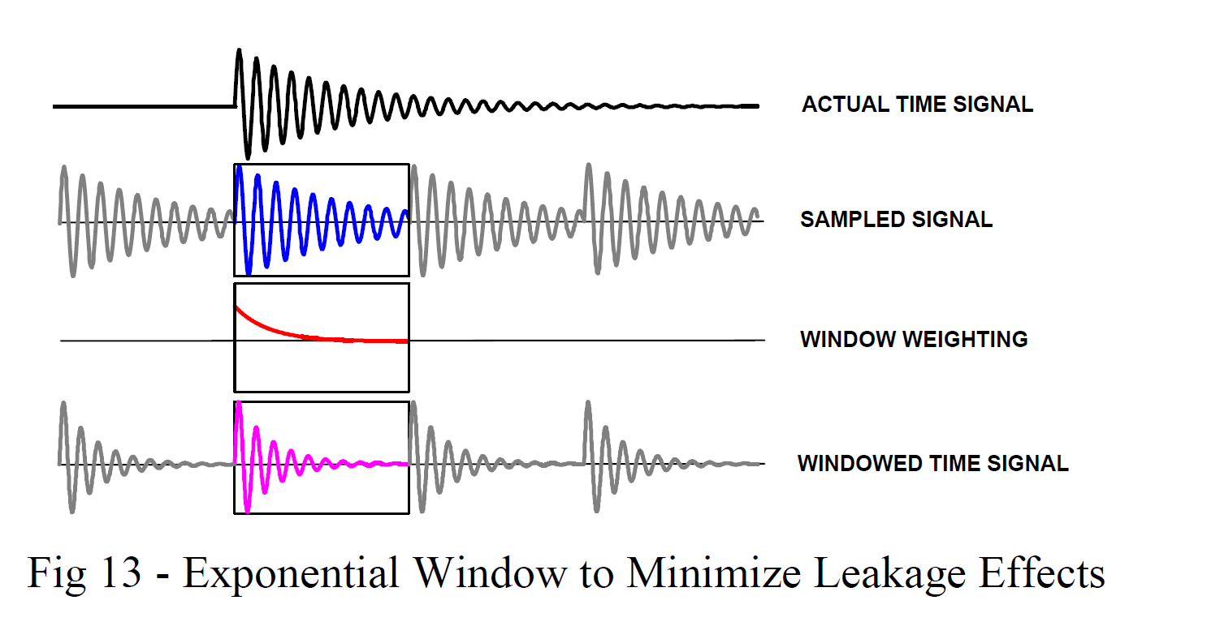
Leakage (Continue)

Slide 16

Example: Different Hammer Tips

Slide 17
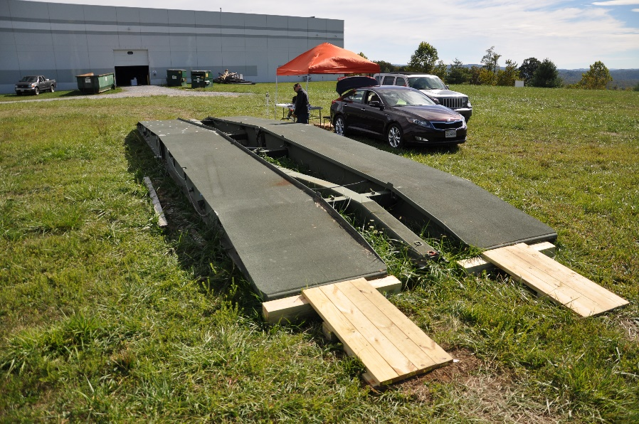
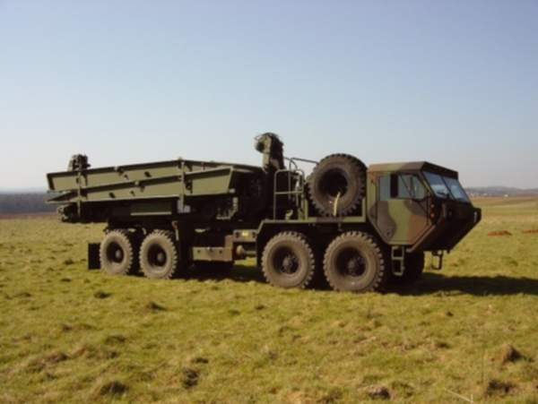
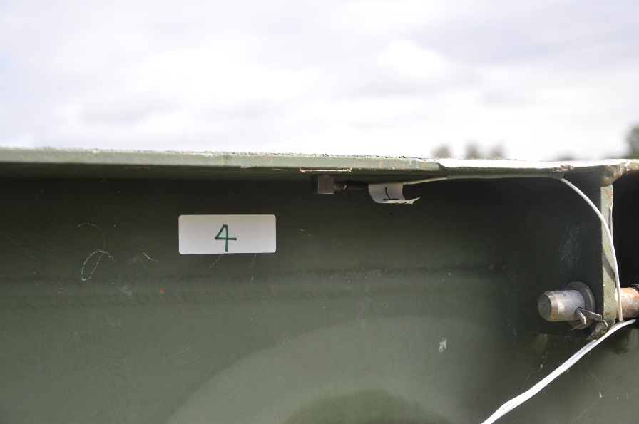
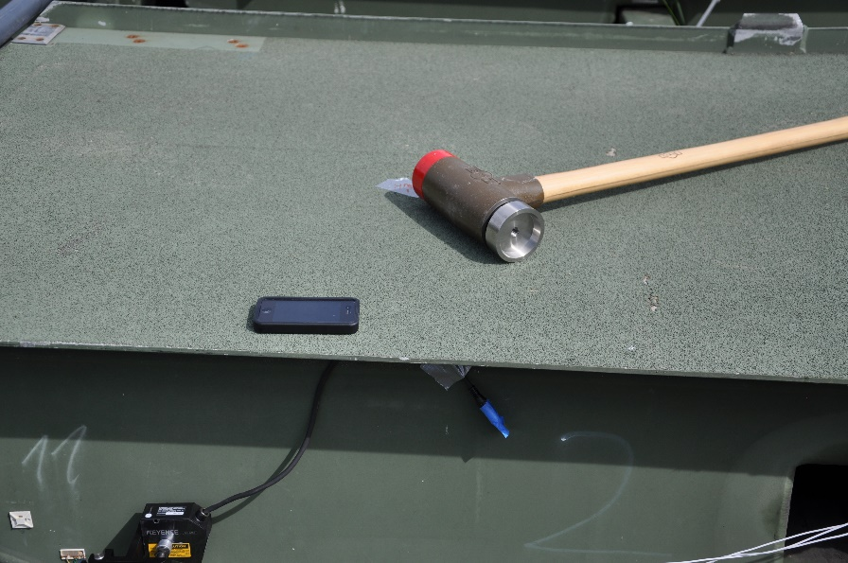
Example: Modal Testing of Rapid Emplaced Bridge System
more images

Slide 18
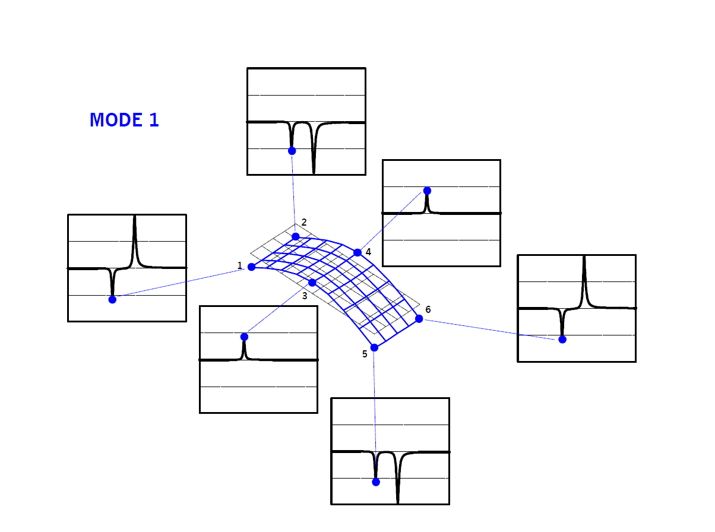
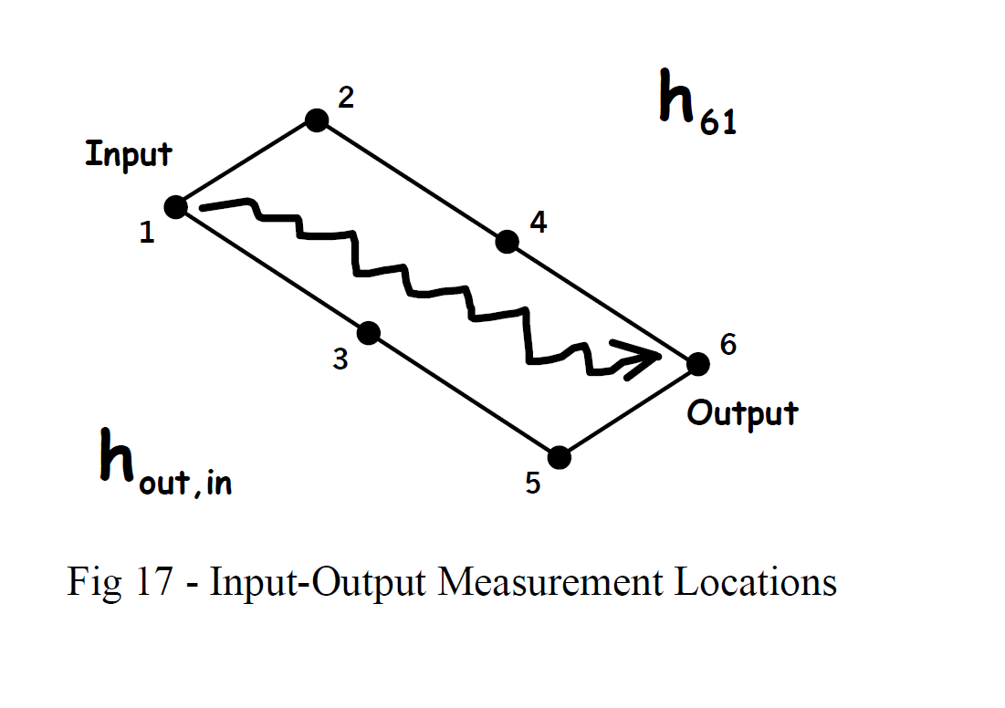
How do I Get Mode Shapes from the Plate FRFs?

Slide 19
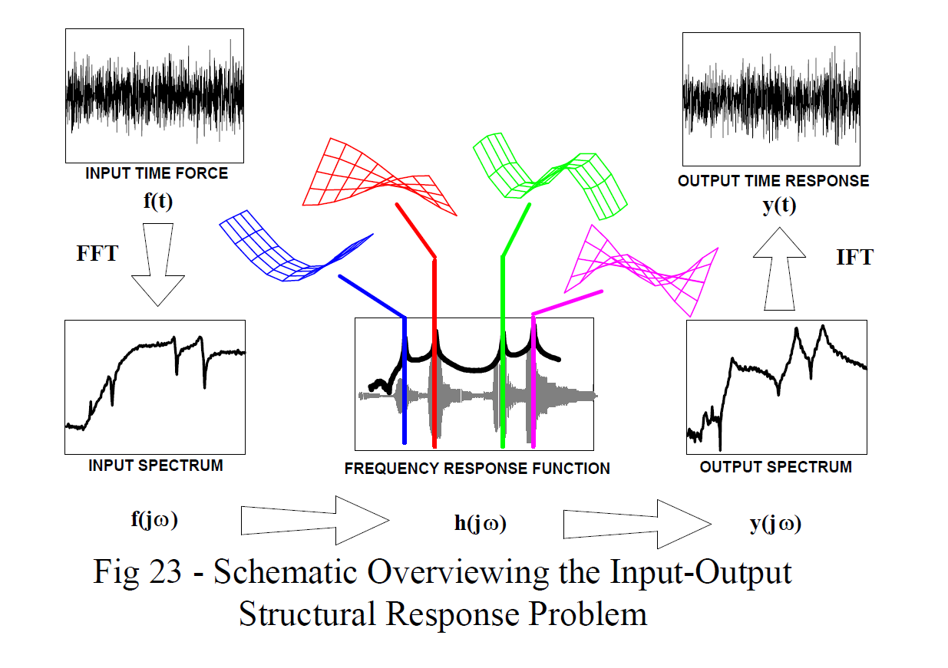
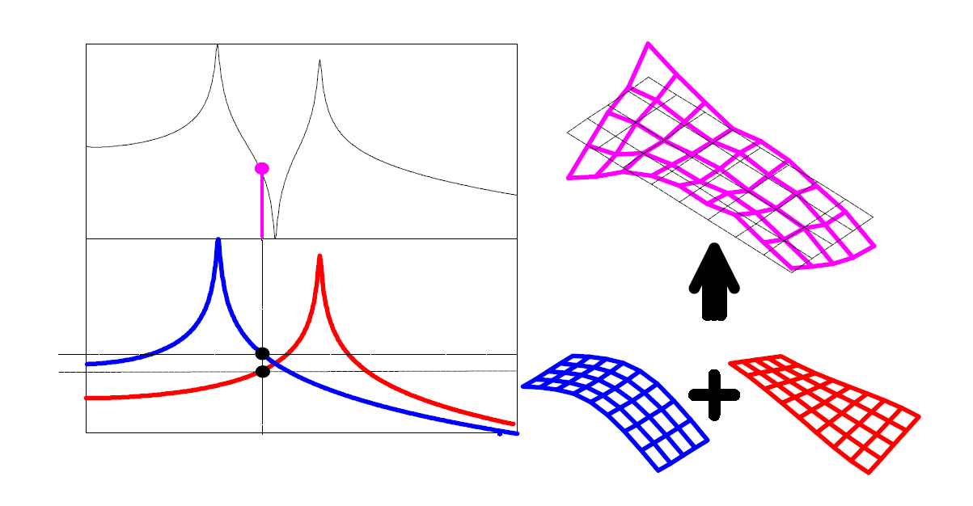
Input-Output Structural Response Problem
The frequency response function acts as a filter on the input force which results in some output response.
The excitation causes all the modes to be activated and therefore, the response is, in general, the linear superposition of all the modes that are activated by the input excitation.
Mode shapes are summed together in some linear fashion to form the operating deflection patterns.

Slide 20
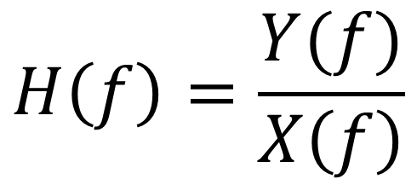
Frequency Response Function
$$H\left(f\right)=\frac{Y(f)}{X\left(f\right)}$$
A frequency response function is a mathematical representation of the relationship between the input and the output of a system.
The ratio of the output response a structure due to an applied force.

Slide 21
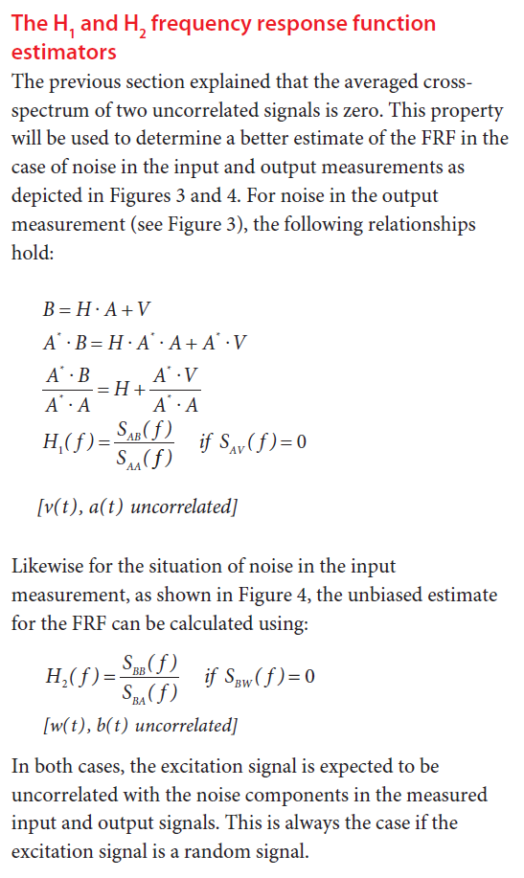
H1 and H2 Frequency Response Function

Slide 22
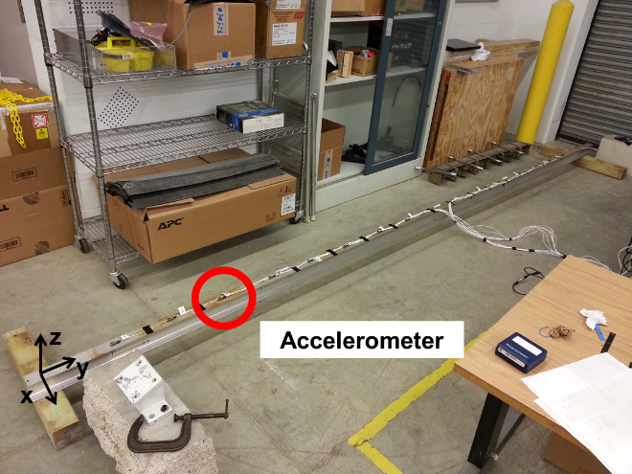
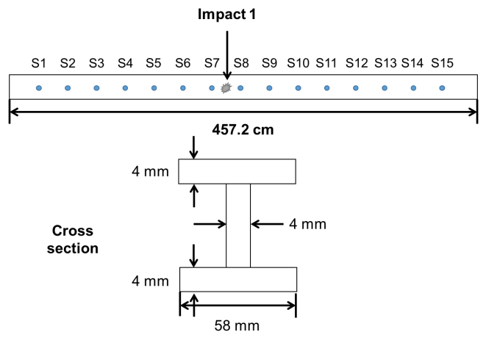
Example: Modal Testing of a Beam Structure

Slide 23
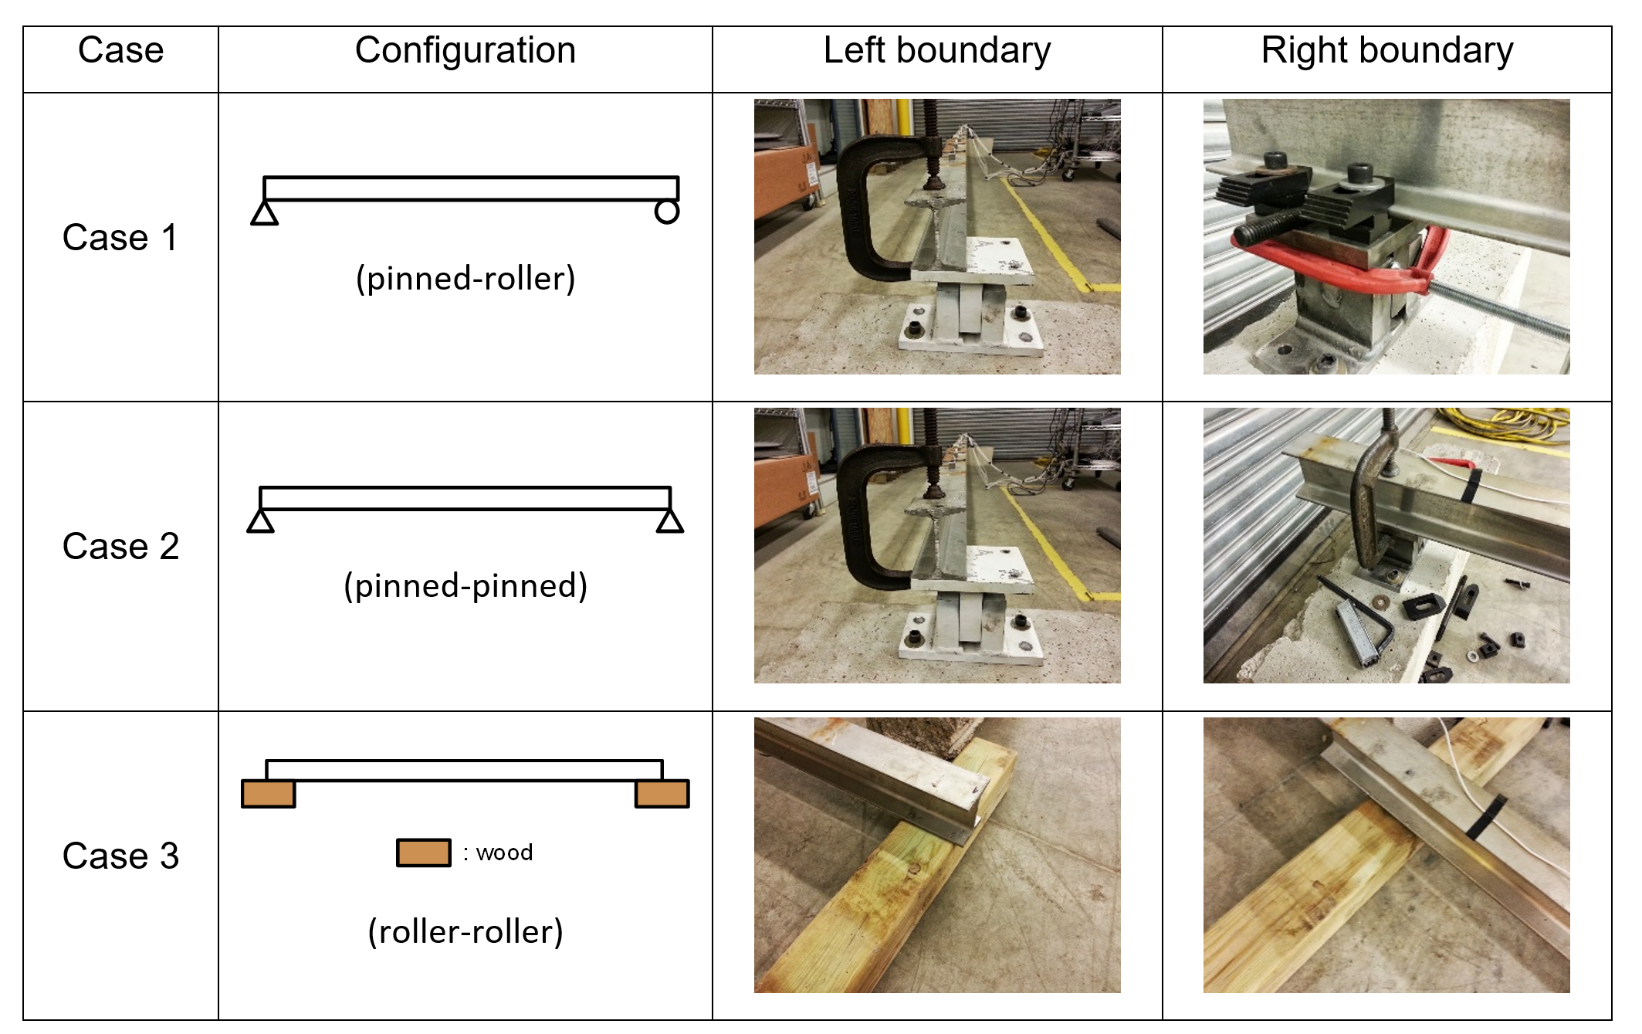
Example: Configurations of Boundary Conditions

Slide 24
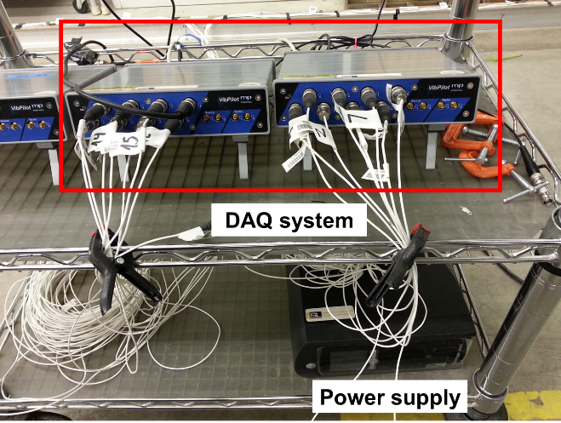
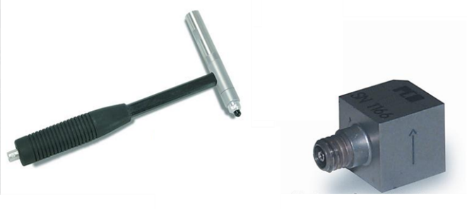
Example: Test Equipment

Slide 25
Mode Shapes and Natural Frequencies
Mode | Case 1 | Case 2 | Case 3
1st | 13 Hz | 14.16 Hz | 12.13 Hz
2nd | 48.69 Hz | 50 Hz | 47.75 Hz
3rd | 116.5 Hz | 92.28 Hz | 102.5 Hz

